Slide 1
Cloud Scale Machine Learning
Understanding Azure Machine Learning service

Slide 2
Preamble – The Agenda
An Overview of Machine Learning
Lab – Hands on with scikit-learn and TensorFlow
Understanding Azure Machine Learning service
Lab – Your First Machine Learning Experiment in the Cloud
Advanced Experimentation Techniques in Azure Machine Learning service
Lab – Hands-on Advanced Experimentation in Azure Machine Learning service
The Intersection of Data Science and DevOps
Lab – Automating your Machine Learning Pipeline in the Cloud

Slide 3
Preamble – The Agenda
An Overview of Machine Learning
Lab – Hands on with scikit-learn and TensorFlow
Understanding Azure Machine Learning service
Lab – Your First Machine Learning Experiment in the Cloud
Advanced Experimentation Techniques in Azure Machine Learning service
Lab – Hands-on Advanced Experimentation in Azure Machine Learning service
The Intersection of Data Science and DevOps
Lab – Automating your Machine Learning Pipeline in the Cloud

Slide 4


Preamble – Some Initial Thoughts

Slide 5

Preamble – Some Initial Thoughts
https://github.com/cloudscaleml/

Slide 6
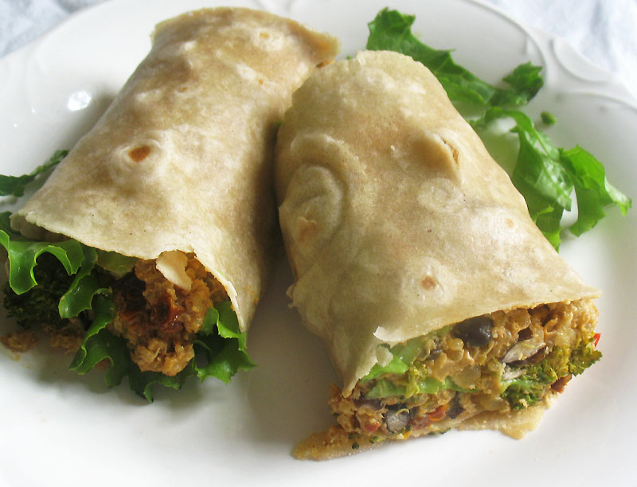

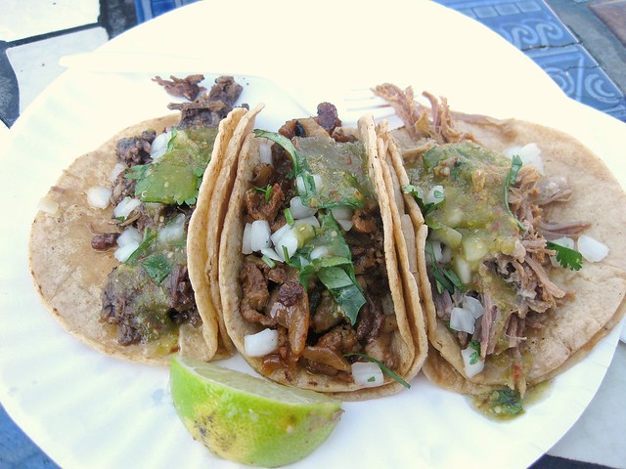
Preamble – What are we making?
burrito
tacos

Slide 7


Slide 8
Programming
algorithm
answer
input
Notes:
In traditional programming, we generally think of the process as designing and implementing an algorithm which, when given an appropriate input, will produce the answer we are looking for.

Slide 9
Machine Learning
answer
algorithm
input
Notes:
But machine learning is different.
Here, we provide some inputs (data), along with the answers (labels) we are looking to get from each input.
For example, each input might be an image, and each answer is the name of the object we want to detect in the image.
In our case, each input is an image of handwritten digit, and the answer is the actual digit it represents.
The machine learning process automatically generates an algorithm for us, from the inputs and the associated answers we provide. We can then use that algorithm to provide answers for new inputs we haven’t seen yet.

Slide 10
Machine Learning
science-y
things
model
data
Notes:
In machine learning circles, that algorithm is called a model, and the inputs and answers are collectively referred to as data. Typically, we need a *lot* of data – and the more complex the task, the more data we need.
You’ve probably heard about the various “science-y” things that can be used to build these models: things live boosted trees and convolutional neural networks. You’ve probably also head to the tools that people use to run them, like scikit-learn and PyTorch and Tensorflow. We’re not going to get into the details of how they work in this session, but for now the important thing to take away is that we start with a lot of data, use a computational framework (and a lot of CPU or GPU-hours) to analyze the data, and the output is a model we will use to generate predictions.

Slide 11
science
Notes:
This is the idealized process.

Slide 12
science
Notes:
This is what actually happens: the “loop of pain”, when we discover our assumptions were wrong, or the data was inadequate, or that we needed to solve a different problem entirely.

Slide 13
The Model Building Process
Prepare Data
Find, Select and/or Create Data
Train Model
Apply learning algorithm
Test Model
Test Candidate Model with unseen data
Deploy Model
Deploy Chosen Model
Apply preprocessing
Select Candidate model
Select good enough model
Application posts to API
Feature Engineering

Slide 14

AI on the Cloud

Slide 15





Machine Learning on Azure
Domain specific pretrained models
To reduce time to market
…
Vision
Speech
Language
Search
Familiar Data Science tools
To simplify model development
PyCharm
Jupyter
Visual Studio Code
Command line
Popular frameworks
To build advanced deep learning solutions
Pytorch
TensorFlow
Scikit-Learn
Onnx
Productive services
To empower data science and development teams
Azure Databricks
Azure Machine Learning
Machine Learning VMs
Powerful infrastructure
To accelerate deep learning
CPU
GPU
FPGA

Slide 16


Machine Learning
Typical E2E Process
Prepare
Experiment
Deploy
…
Prepare Data
Build model (your favorite IDE)
Train & Test Model
Register and Manage Model
Build Image
Deploy Service
Monitor Model
Orchestrate

Slide 17
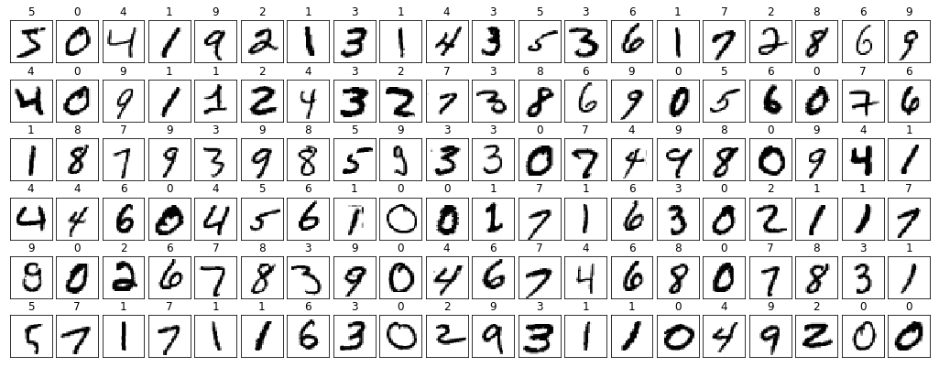
Notes:
Here are two examples of the training images we’ll be working with.
The first image is labelled as the digit “two”.
The second is labelled as the digit “one”.
TODO: Yann Lecun reference??

Slide 18
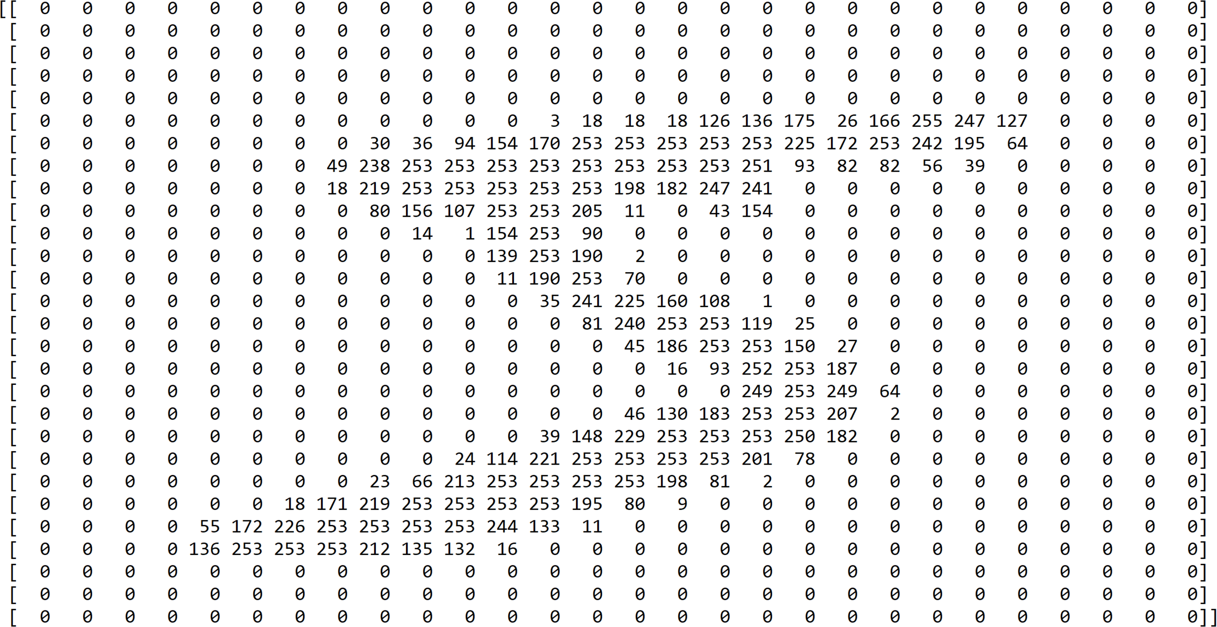

Slide 19

create model locally

Slide 20
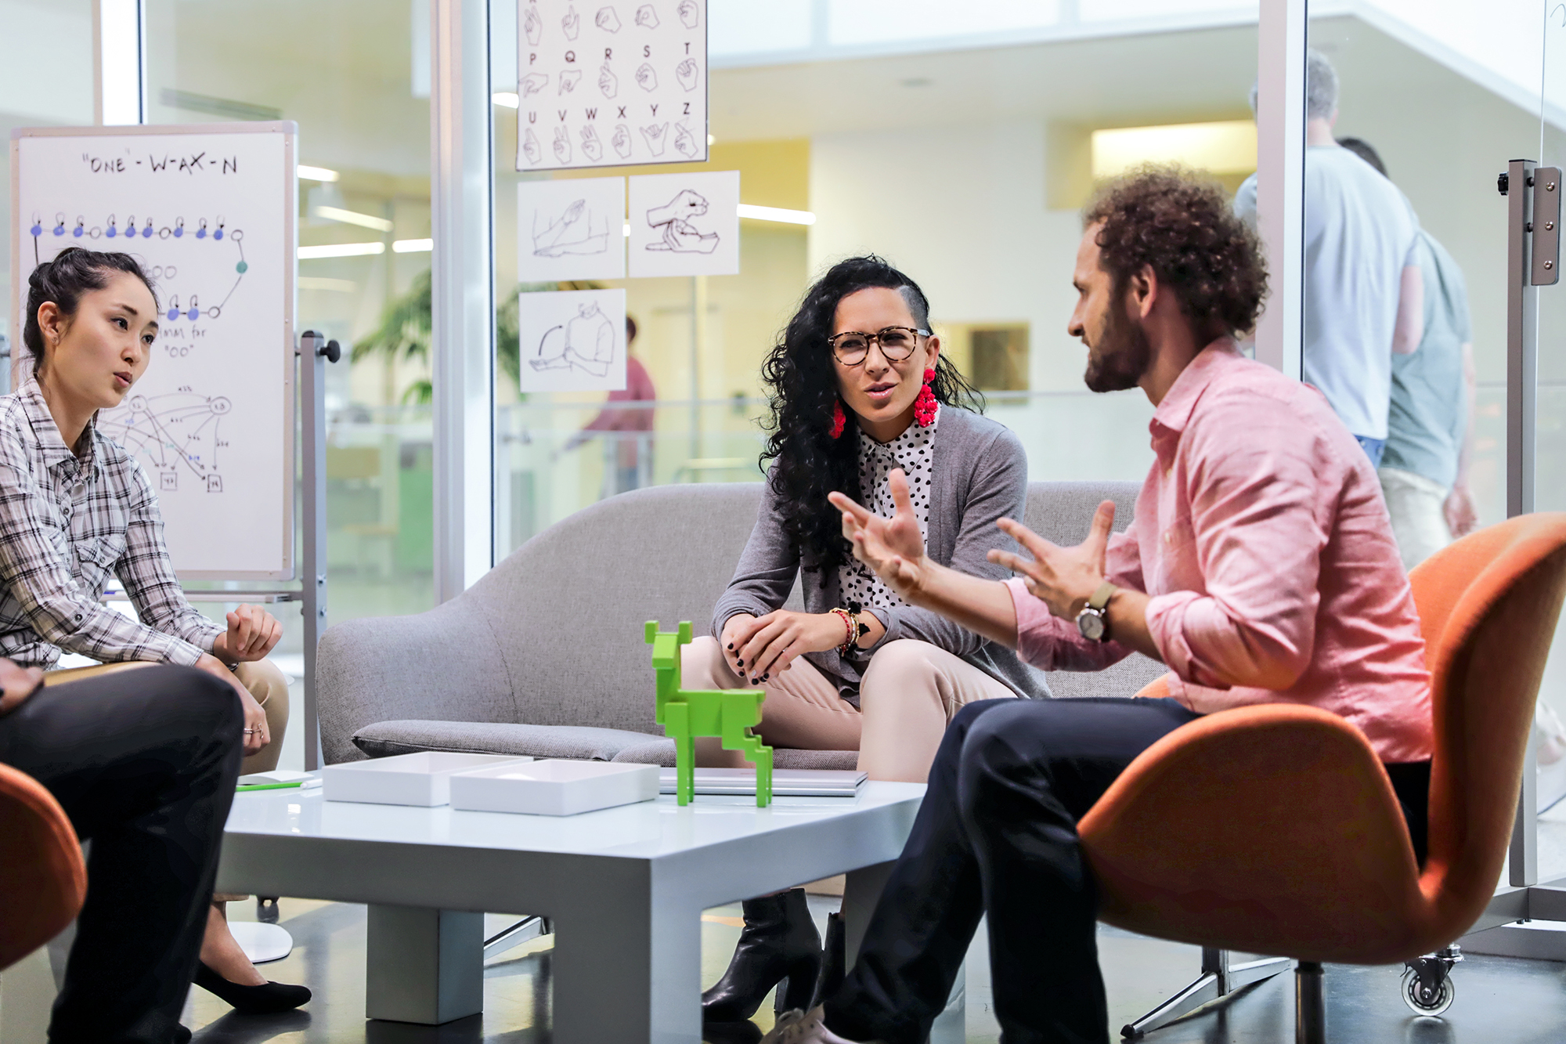
working with others
Notes:
made up story of a team

Slide 21
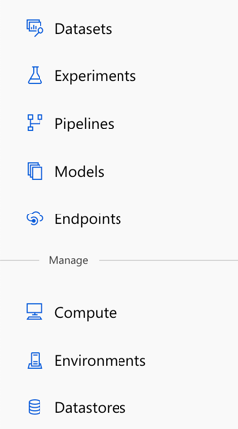
Azure Machine Learning
Datasets – registered, known data sets
Experiments – Training runs
Pipelines – Training workflows
Models – Registered, versioned models
Endpoints:
Real-time Endpoints – Deployed model endpoints
Pipeline Endpoints – Training workflow endpoints
Compute – Managed compute
Environments – defined training and inference environments
Datastores – Connections to data
Notes:
[Just list and describe as per the individual points]

Slide 22

workspace and compute

Slide 23
Azure Machine Learning
Datasets – registered, known data sets
Experiments – Training runs
Pipelines – Training workflows
Models – Registered, versioned models
Endpoints:
Real-time Endpoints – Deployed model endpoints
Pipeline Endpoints – Training workflow endpoints
Compute – Managed compute
Environments – defined training and inference environments
Datastores – Connections to data
Notes:
We’re going to focus for the moment on Pipelines. Pipelines are workflows for training our models, and we want to build one so we can have a repeatable way to build our predictive model.

Slide 24

showing your work
Notes:
back to made up story (this time someone leaves the team)

Slide 25
running experiments

Slide 26
Azure Machine Learning
Datasets – registered, known data sets
Experiments – Training runs
Pipelines – Training workflows
Models – Registered, versioned models
Endpoints:
Real-time Endpoints – Deployed model endpoints
Pipeline Endpoints – Training workflow endpoints
Compute – Managed compute
Environments – defined training and inference environments
Datastores – Connections to data
Notes:
[Just list and describe as per the individual points]

Slide 27




Azure ML
Workspace
1. Snapshot folder and
send to experiment
2. create docker image
6. Stream stdout, logs, metrics
Docker Image
5. Launch script
3. Deploy docker and snapshot to compute
6. Stream stdout, logs, metrics
7. Copy over outputs
Compute Target
4. Mount datastore to compute
Data Store
My Computer
Notes:
DANIEL slide
Explain the flow step by step

Slide 28
Azure Machine Learning
Datasets – registered, known data sets
Experiments – Training runs
Pipelines – Training workflows
Models – Registered, versioned models
Endpoints:
Real-time Endpoints – Deployed model endpoints
Pipeline Endpoints – Training workflow endpoints
Compute – Managed compute
Environments – defined training and inference environments
Datastores – Connections to data
Notes:
[Just list and describe as per the individual points]

Slide 29

models
Notes:
Use following slides as a recap of the demo you just did.

Slide 30

Create images
+
Scoring file.py
+
Python Environment

Slide 31


Deploy image
+
Scoring file.py
+
Python Environment
+
Azure Kubernetes Service (AKS)
or
Azure Container Instance

Slide 32
Azure Machine Learning
Datasets – registered, known data sets
Experiments – Training runs
Pipelines – Training workflows
Models – Registered, versioned models
Endpoints:
Real-time Endpoints – Deployed model endpoints
Pipeline Endpoints – Training workflow endpoints
Compute – Managed compute
Environments – defined training and inference environments
Datastores – Connections to data
Notes:
[Just list and describe as per the individual points]

Slide 33

Azure Machine Learning service
Questions?

Slide 34
Lab
Your First Machine Learning Experiment in the Cloud

